Slide 1
Đại học Thăng Long
Tổng quan về SQL Server
Giảng viên: Trần Quang Duy

Slide 2
Content
Overview SQL Server 2008/2012
  SQL Server Edition
  SQL Server Components
SQL Server Management Studio
  Registered Servers
  Object Explorer
  Summary page
<number>/25

Slide 3
Mục tiêu
Objectives: In this hour you'll learn
  SQL Server 2008 Components
  The versions of SQL Server 2008 that are available
  Using SQL Server Management Studio
<number>/25

Slide 4
Overview SQL Server 2008
SQL Server is a database and data analysis platform for large-scale online transaction processing (OLTP), data warehousing, and e-commerce applications. (Books online)
<number>/25

Slide 5
SQL Server 2008 Edition
SQL Server 2008 Enterprise Edition (32-bit and 64-bit): server environments
SQL Server 2008 Standard Edition (32-bit and 64-bit): server environments
SQL Server 2008 Workgroup Edition (32-bit only): server environments
SQL Server 2008 Developer Edition (32-bit and 64-bit)
SQL Server 2008 Express Edition (32-bit only)
SQL Server 2008 Mobile Edition (SQL Server CE)
<number>/25

Slide 6
SQL Server 2008 Enterprise Edition
Includes all the tools that you need to manage an enterprise database management system.
Offers a complete set of enterprise management and business intelligence features, and provides the highest levels of scalability and availability of all the SQL Server 2008 editions.
It supports an unlimited number of CPUs and provides all the features unavailable in the other versions of SQL Server 2005.
<number>/25

Slide 7
SQL Server 2008 Standard Edition
Is the data management and analysis platform for small- and medium-sized organizations.
It includes the essential functionality needed for e-commerce, data warehousing, and line-of-business solutions.
Standard Edition is ideal for the small- to medium-sized organization that needs a complete data management and analysis platform.
<number>/25

Slide 8
SQL Server Workgroup Edition
Provides a great solution for small organizations or workgroups within larger entities.
It includes a rich feature set, but is affordable and simple to work with. There is no limit on database size and that it supports the SQL Agent Job Scheduling Service
The disadvantages of SQL Server 2008 Workgroup Edition include
  Support for only three gigabytes of RAM
  Support for only two CPUs
  Absence of the Database Tuning Advisor
<number>/25
Notes:
SQL Server Workgroup Edition provides a great solution for small organizations or workgroups within larger entities. It includes a rich feature set, but is affordable and simple to work with. Other valuable features include the fact that there is no limit on database size and that it supports the SQL Agent Job Scheduling Service. The disadvantages of SQL Server 2005 Workgroup Edition include
Support for only three gigabytes of RAM
Support for only two CPUs
Absence of the Database Tuning Advisor

Slide 9
SQL Server 2008 Developer Edition
Is designed specifically for developers who are building SQL Server 2008 applications.
It includes all functionality of SQL Server 2008 Enterprise Edition, but with a special license that limits its use to development and testing.
Its license specifies that you cannot use it for production development
<number>/25

Slide 10
SQL Server 2008 Express
Is a free, easy-to-use, and simple-to-manage database. Integrated with Microsoft Visual Studio 2008
SQL Server Express makes it easy to develop data-driven applications that are rich in capability, secure in storage, and fast to deploy.
SQL Server Express is free and can be redistributed (subject to agreement), and functions as the client database, as well as a basic server database.
Disadvantages:
  Support for only one gigabyte of RAM
  Support for a four-gigabyte maximum database size
  Support for only one CPU
  Absence of the SQL Agent Job Scheduling Service
  Absence of the Database Tuning Advisor
<number>/25

Slide 11
SQL Server 2008 Mobile Edition
Extends Microsoft enterprise solutions to line-of-business and personal information management (PIM) applications on a device.
SQL Server 2008 Mobile Edition enables you to easily port corporate applications over to mobile devices
SQL Server Mobile is a mobile database platform that is designed for developers who develop Microsoft Windows mobile-based devices. Its characteristic features are a robust data store, an optimizing query processor, and reliable, scalable connectivity capabilities
<number>/25
Notes:
Port: Lap trinh mot ung dung
Extends Microsoft enterprise solutions to line-of-business and personal information management (PIM) applications on a device, and provides developers with a consistent programming model for rapid application development. SQL Server Mobile delivers necessary relational database functionality in a small footprint: a robust data store, an optimizing query processor, and reliable, scalable connectivity capabilities.

Slide 12
SQL Server 2008 Components
Database Engine
Reporting Services
Analysis Services
Notification Services
Integration Services
Full-Text Search
Replication
Service Broker
<number>/25
Notes:
The Database Engine
is the core service for storing, processing and securing data. The Database Engine provides controlled access and rapid transaction processing to meet the requirements of the most demanding data consuming applications within your enterprise. The Database Engine also provides rich support for sustaining high availability.
Reporting Services
Nếu có một công nghệ được mọi người dùng nhiều nhất khi truy cập vào SQL Server 2005 thì đó chính là dịch vụ báo cáo Reporting Services. Với hầu hết người dùng, báo cáo vẫn là trái tim của việc quản lý CSDL. Với Report Builder mới và Report Designer đã được cải thiện rất nhiều. Tất cả đã được tích hợp hoàn toàn với BIDS.
Analysis Service
Có nhiều thay đổi được thực hiện đối với công cụ Analysis Service, thỉnh thoảng được xem như là công cụ phân tích kinh doanh (Business Analytics). Được xây dựng từ nền tảng SQL Server 2000 Analysis Services, Microsoft SQL Server 2005 Analysis Service (SSAS) hỗ trợ thêm cho chức năng khai thác thông tin (Business Intelligent), khả năng mở rộng gia tăng, tính sẵn có và bảo mật cho các giải pháp Business Intelligent trong khi làm cho chúng dễ tạo, dễ triển khai và dễ quản lý.
Analysis Services delivers online analytical processing (OLAP) and data mining functionality for business intelligence applications. Analysis Services supports OLAP by allowing you to design, create, and manage multidimensional structures that contain data aggregated from other data sources, such as relational databases. For data mining applications, Analysis Services enables you to design, create, and visualize data mining models. These mining models can be constructed from other data sources by using a wide variety of industry-standard data mining algorithms.
Notification Services
Notification Services is an environment for developing and deploying applications that generate and send notifications. You can use Notification Services to generate and send timely, personalized messages to thousands or millions of subscribers, and can deliver the messages to a variety of devices.
SQL Server Integration services
(SSIS) là một cải tiến từ dịch vụ biến đổi dữ liệu (Data Transformation). Những khác biệt chính bao gồm việc giới thiệu các công cụ thể hiện dạng đồ họa như SSIS Designer thông qua BIDS và SQL Server Import and Export Wizard. Tăng khả năng mở rộng bằng cách sử dụng các tác vụ tùy chỉnh, nguồn dữ liệu, nơi lưu gửi dữ liệu tới và những biến đổi dữ liệu. những thay đổi về kiến trúc.
Integration Services is a platform for building high performance data integration solutions, including packages that provide extract, transform, and load (ETL) processing for data warehousing.
Full-Text Search
Full-Text Search contains the functionality you can use to issue full-text queries against plain character-based data in SQL Server tables. Full-text queries can include words and phrases, or multiple forms of a word or phrase.
Replication
Replication is a set of technologies for copying and distributing data and database objects from one database to another, and then synchronizing between databases to maintain consistency. By using replication, you can distribute data to different locations and to remote or mobile users by means of local and wide area networks, dial-up connections, wireless connections, and the Internet.
Service Broker
Cho phép tạo các ứng dụng để trao đổi dữ liệu theo cơ chế không đồng bộ.
Service Broker helps developers build scalable, secure database applications. This new Database Engine technology provides a message-based communication platform that enables independent application components to perform as a functioning whole. Service Broker includes infrastructure for asynchronous programming that can be used for applications within a single database or a single instance, and also for distributed applications.

Slide 13
SQL Server Management Studio
The main tool that use to administer SQL Server 2008 databases.
To administer SQL Server instances, Analysis Services instances, Integration Services instances, and Reporting Services instances
<number>/25
Notes:
Note:
You can also use it to administer
SQL Server 2000 databases. You cannot use SQL Server Management Studio to administer SQL Server 7.0
databases.
SQL Server Management Studio has replaced familiar tools such as
Enterprise Manager and Query Analyzer in SQL Server 2000. If you go looking
for Enterprise Manager and Query Analyzer, you won’t find them in a SQL
Server 20005 installation.

Slide 14
SQL Server Management Studio
Running Management Studio
Registering a SQL Server instance
Exploring the Object Explorer
Looking over the Summary tab
Querying with the query pane
Applying templates in Management Studio
<number>/25

Slide 15
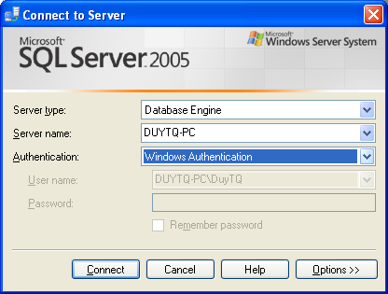
Starting SQL Server Management Studio
On the Start\All Programs\Microsoft SQL Server 2008\SQL Server Management Studio.
In the Connect to Server dialog box, verify the default settings, and then click Connect.
<number>/25

Slide 16
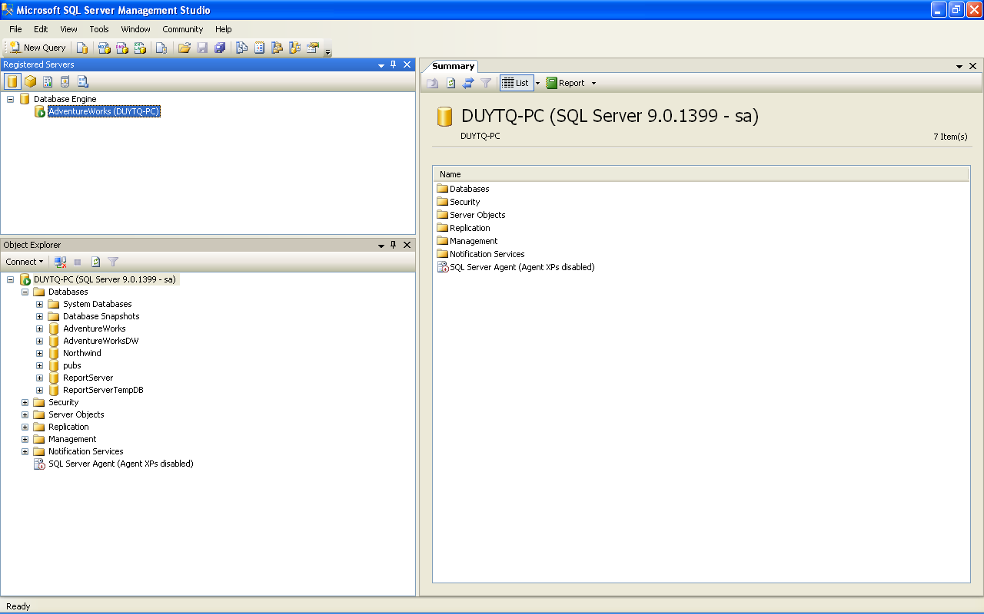
SQL Server Management Studio
Three component
  Registered Servers
  Object Explorer
  the Summary page
<number>/25

Slide 17
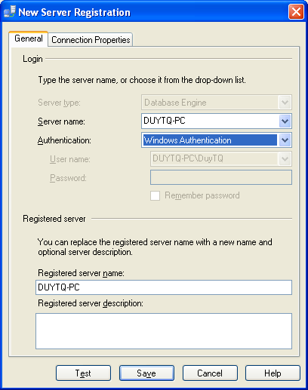
Using Register Server
On the Registered Servers toolbar, click Database Engine if necessary. (It may already be selected.)
Right-click Database Engine, point to New, and then click Server Registration. The New Server Registration dialog box opens.
In the Server name text box, type the name of your SQL Server instance.
In the Registered server name box, type AdventureWorks.
On the Connection Properties tab, in the Connect to database list, select AdventureWorks, and then click Save.
<number>/25

Slide 18
Object Explorer
To connect with Object Explorer
  Click the relevant icon on the Registered Servers toolbar to select the type of instance to connect to.
  Right-click the SQL Server instance that you want to connect to.
  From the context menu, choose Connect\Object Explorer.
  (Or On the toolbar of Object Explorer, click Connect to drop down the list of possible connection types, and then select Database Engine. The Connect to Server dialog box opens.)
To connect with new query
  Click the relevant icon on the Registered Servers toolbar to select the type of instance to connect to.
  Right-click the SQL Server instance that you want to connect to.
  From the context menu, choose Connect\New Query.
<number>/25

Slide 19
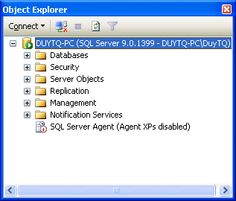
Exploring the Object Explorer
The Object Explorer allows
  Create and manage databases
  View and modify database properties
  Create and manage database objects such as tables and views
  Grant and revoke privileges and permissions
  Configure replications
  Manage SQL Server Integration Services packages
  View SQL Server and Windows log files
  Manage SQL Server Agent
<number>/25
Notes:
The Object Explorer allows you to carry out several management tasks in Management Studio depending which instance type you chose:

Slide 20
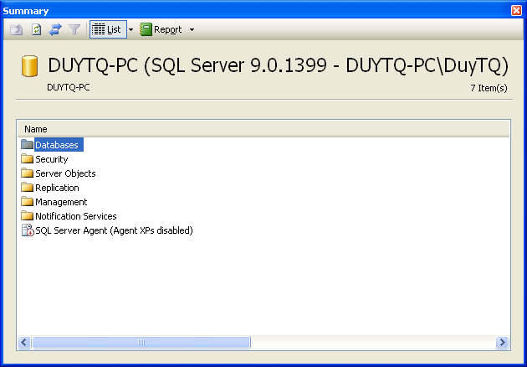
Sumary
Provides information that summarizes some characteristics of the SQL Server instance
<number>/25

Slide 21
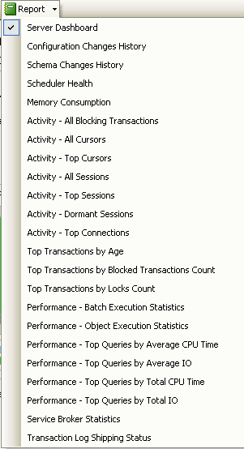
Sumary - Report
Report
<number>/25

Slide 22
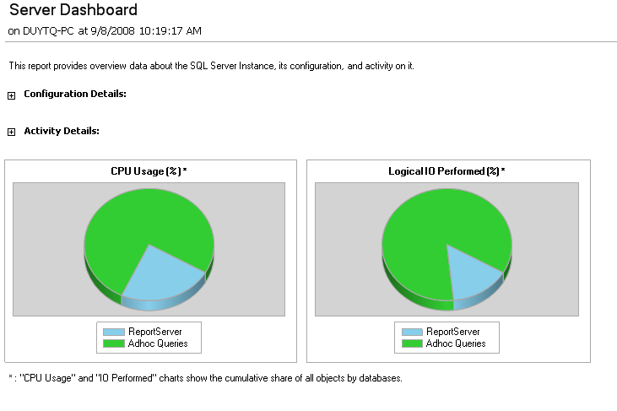
Sumary - Report
<number>/25

Slide 23
Query Pane
  To create a new query, click the New Query button on the Standard toolbar.
  The five types of query supported in Management Studio are
    Transact-SQL:Runs against the relational database engine
    MDX (Multi-Dimensional Expressions):Runs against Analysis Services
    DMX (Data Mining Extensions):Runs against Analysis Services
    XMLA (XML for Analysis):Runs against Analysis Services
    SQL Server Mobile Query:Runs against an instance of SQL Server 2005 Mobile Edition
<number>/25

Slide 24
Customizing the Environment
Customizing the Environment:Choose Tools\options
  Setting Startup options: General tab
  Displaying results: Query Results tab
  Keyboard shortcuts: General\Keyboard
  Restoring the default configuration: chooseWindow\Reset Window Layout.
  Using templates in Management Studio: View\Template Explorer.
<number>/25

Slide 25
Reference
Books online
  https://docs.microsoft.com/en-us/sql/sql-server/sql-server-technical-documentation
Pro SQL Server Administration, Peter A Carter, 2015, Apress Pub, ISBN: 9781484207116
Microsoft SQL Server2005 For Dummies, Published by
Wiley Publishing, Inc. 111 River Street
<number>/25

